Slide 1
Project Documentation: Furniture Sales Performance Dashboard
Project Title: Furniture Sales Performance Dashboard (Excel)
Tool Used: Microsoft Excel
Project Summary: This dashboard was created as part of a hands-on end-to-end Excel tutorial project. It showcases the performance of furniture sales across different regions in the U.S., using real-world sales data. From Power Query to Pivot Tables and Pivot Charts, this project walks through the full data transformation and dashboard-building process, helping beginners and intermediates understand how to build beautiful, functional dashboards in Excel.
Skills Applied:
Data Cleaning & Transformation (Power Query)
Pivot Table and Pivot Chart Analysis
Dynamic Title Creation
Region/Segment Filtering
Custom Dashboard Layout & Design
Dashboard Overview
The dashboard provides visual insights into the following:
Key Metrics: Total Sales, Profit, Quantity (with YoY % growth)
Shipping Mode: Most used shipment methods and their distribution
Sales Trend: Monthly breakdown with peak month highlighted
Shipping Duration: Delivery days and their distribution
Category Performance: Top furniture categories by sales
State-wise Sales: Geographic visualization using a map
Top Cities: Best-performing cities by quantity of orders
Interactive Filters: Region and Segment slicers for dynamic insights

Slide 2
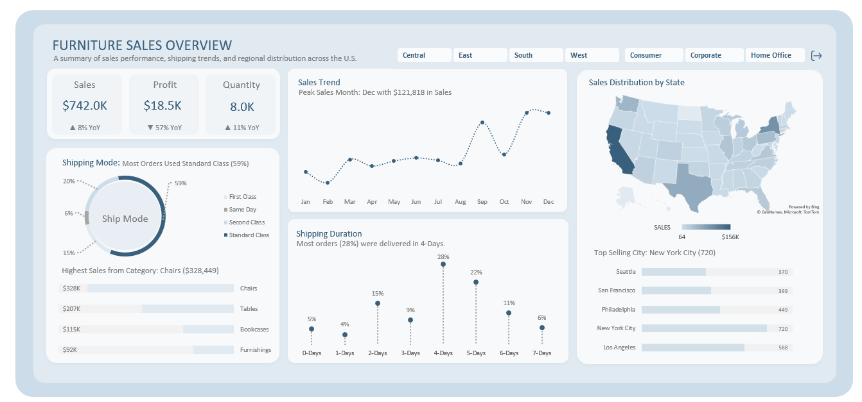
COLOR PALETTE
#385F7C
#7F7F7F
#CCDCE8
#E1EAF1
#F8F9FA
#E1EAF1
www.linkedin.com/in/freedomoboh
http://www.youtube.com/@ObohYT
https://x.com/ObohX

